Slide 1
Tehseen Rubbab Committed Listner Genspace
Home Work: 3
3 idea

Slide 2
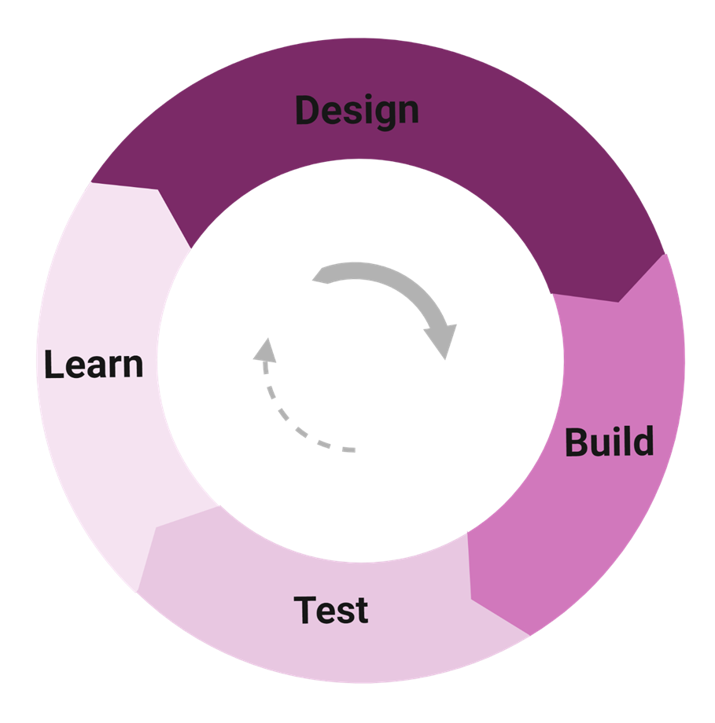
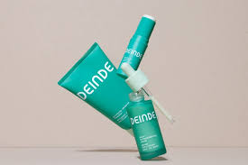

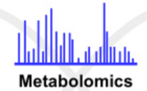
Idea1: Naringenin production through Design Build Test and Learn Strategy
Applications
Clone codon-optimised genes/check for using DBTL cycle and transform into Yeast
Check for expression of constructs having different promoter combinations
Tehseen Rubbab
CL: GenSpace

Slide 3
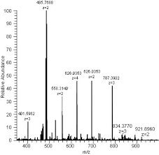
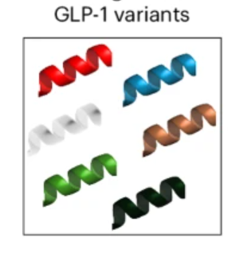

Idea 2: Beyond Lipidation: Glycosylated GLP1 analogue as an alternative to fatty acid-modified Ozempic
AI-driven GLP-1 variants/ insilico screening
Mass Spectrometry
Tehseen Rubbab
CL: GenSpace

Slide 4
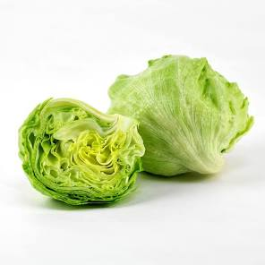
Idea 3: Engineering Plants to produce oxalate oxidase enzyme
Constitutive expression of enzymes having oxalate oxidase activity using CamV35S promoter.
Expression level will be checked through MS
Goals
Enhance plant abiotic stress resistance
Enhance plant defence against fungal pathogens
Reduces oxalate in edible crops
Tehseen Rubbab
CL: GenSpace

